Slide 1
Analysis of Singapore’s Weather Patterns for STB’s Marketing Division’s Online Infographic
DSIF 9 Project 1
Jan 2023

Slide 2
Content
Problem Statement
Background
Analysis Approach
Features used
Key Findings
Recommendations

Slide 3
Problem Statement

Slide 4
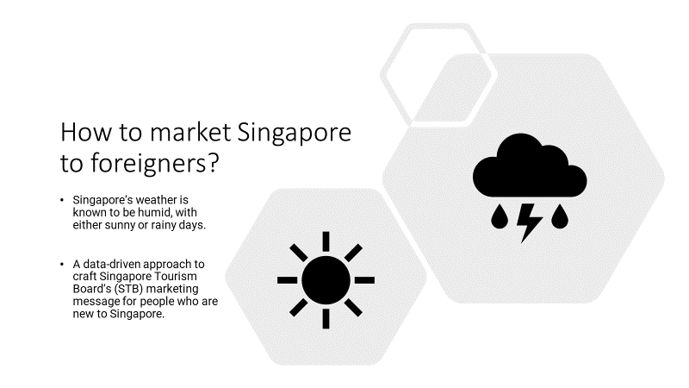

Slide 5
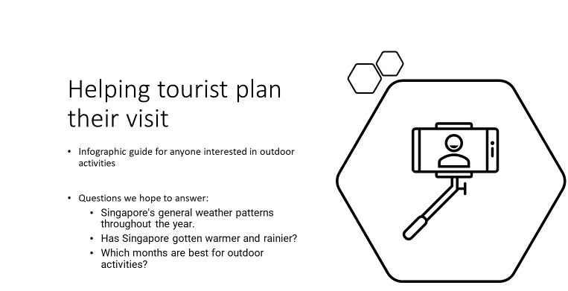

Slide 6
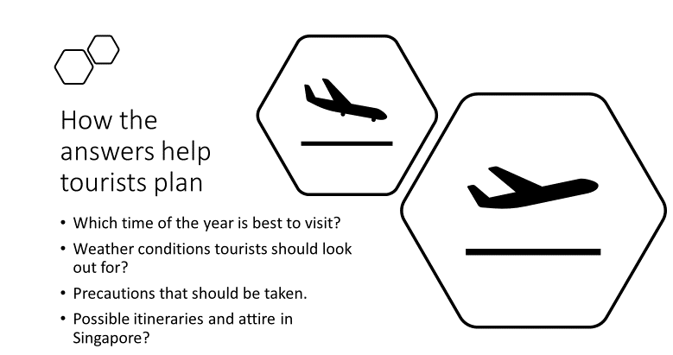

Slide 7
Background

Slide 8
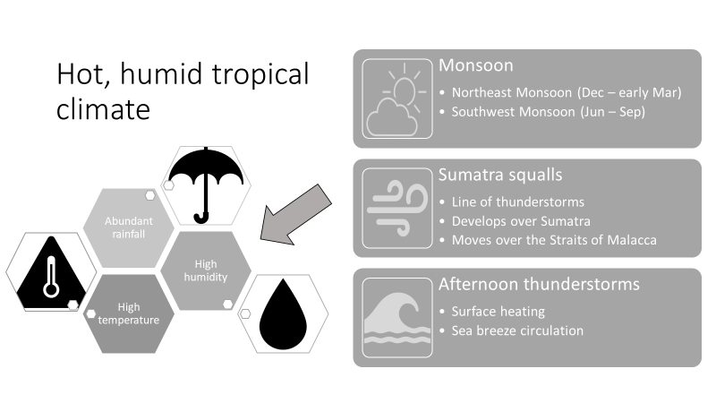
Source: Meteorological Services Singapore

Slide 9
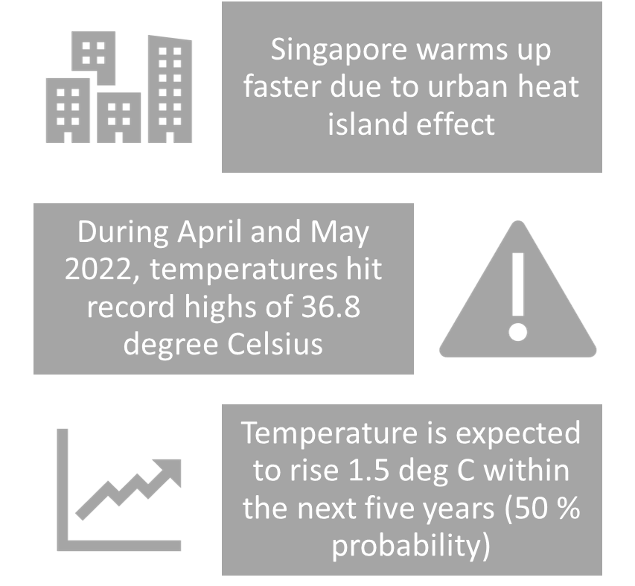
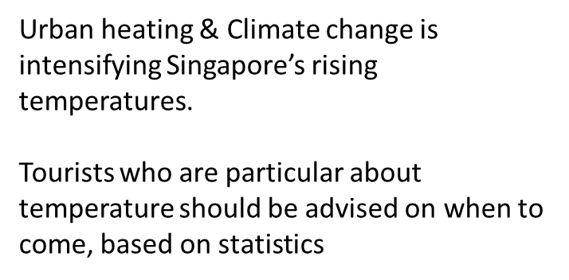

Urban heating & Climate change is intensifying Singapore’s rising temperatures
Sources: The Straits Times (13 May 2022) and Channel NewsAsia (4 Jun 2022)

Slide 10
Datasets and Analysis Approach

Slide 11
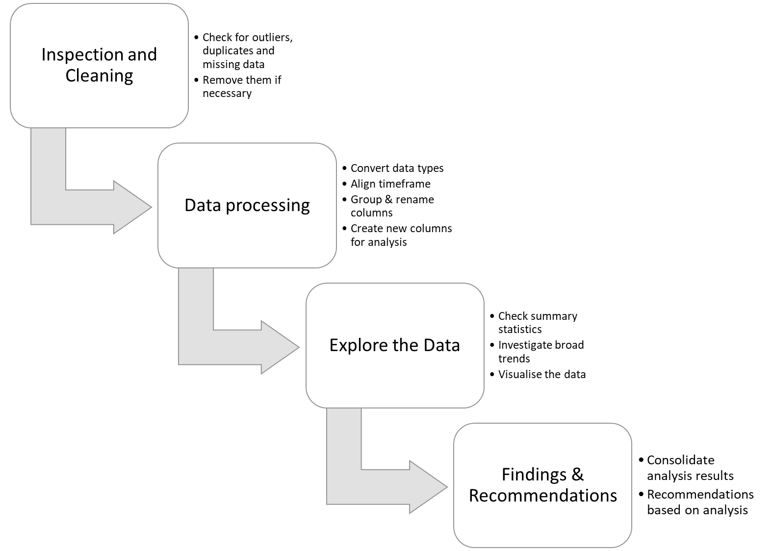
Data Analysis Workflow
Notes: Weather data in Singapore is recorded at the Changi climate station. Datasets were downloaded from data.gov.sg

Slide 12
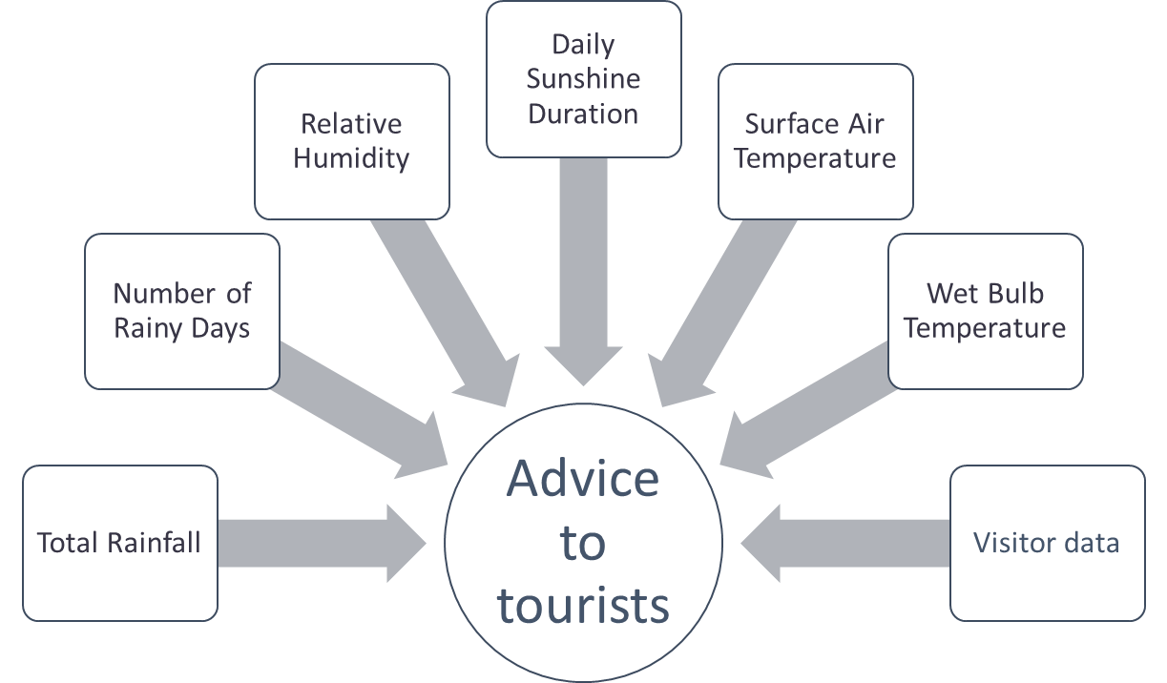
Advice to tourists will be given based on analysis of data
Notes: Weather data in Singapore is recorded at the Changi climate station. Datasets were downloaded from data.gov.sg

Slide 13
Key Findings

Slide 14
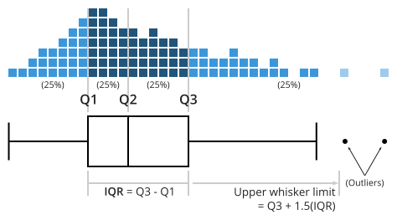
But first….
How to read a boxplot, or a box-and-whisker plot
Boxplots show the distribution of our data, where 25% of data points fall into each box/whisker
Median
Notes:
Thanks Zhiming. In this next section we will share some of our key findings.
But before that, we will be using boxplots to understand our weather and tourism data, so it’s timely now for us to give a very quick primer on what they are.
Boxplots are a way to visualise the distribution of data. The data is first sorted and then arranged into 4 groups which form the box and whiskers. 25% of our data lies in the whisker from the left hand side to Q1, 25% in the box from Q1 to Q2, 25% in the box from Q2 to Q3, and Q3 to the end of the whisker on the right.
The lines dividing the groups are called quartiles. The median marks the mid-point of the data and is shown by the line that divides the box into two parts.

Slide 15
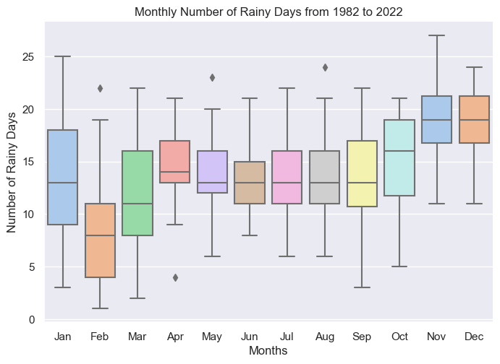
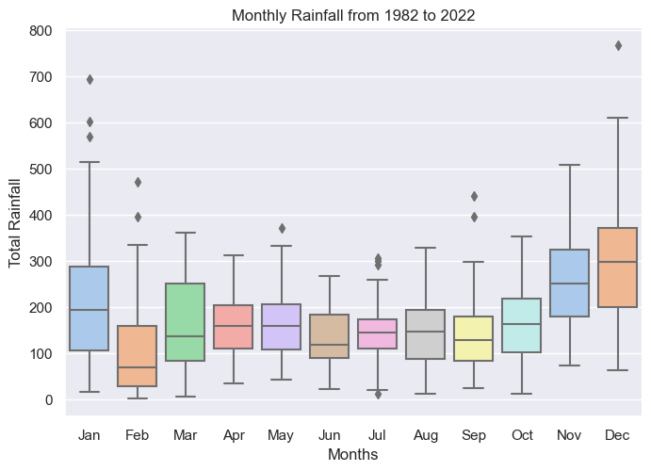
In line with the monsoon seasons, Nov-Jan have the highest rainfall, while Feb-Mar and Sep-Oct tend to have more drier days.
Q. Which months are best for outdoor activities?
Rain
Northeast Monsoon
Southwest Monsoon
Northeast Monsoon
Northeast Monsoon
Southwest Monsoon
Northeast Monsoon
Notes:
One of the research questions we had was to understand which months are better or worse for outdoor activities. We studied rainfall and temperature separately. To visualise Singapore’s monthly rainfall patterns more easily, we created boxplots for rainfall amount and number of rainy days to see which months have the highest and lowest rainfall, since that directly affects whether tourists can spend their day outdoors and purchase tickets to places such as the zoo or Universal Studios.
The trends here indicate that the monsoon months of Nov to Jan see higher rainfall and more days of rain, while the months of Feb and Mar are our driest months. Something to note is also that the possibility of rain is always present even when it’s not monsoon season – on average, we can expect rainfall on at least 15 days each month (except in Feb and Mar).

Slide 16
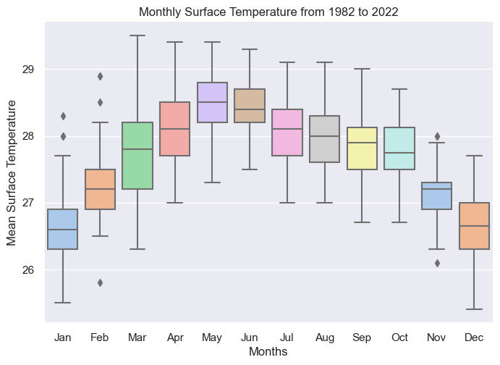
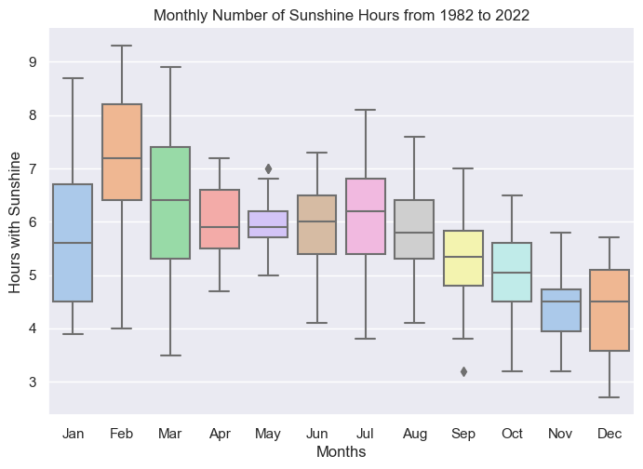
Surface temperatures are highest at mid-year from Apr to Jul, and lowest at the end of the year. In May, typically the warmest month, the median surface temperature is 28.5 degrees Celsius.
Q. Which months are best for outdoor activities?
Heat
Notes:
Now that we have an idea of the rainfall patterns by month, what about the temperatures? Which months are too hot to be outdoors, or don’t have enough sunshine which indicate high cloud cover or rain?
We can see here that our temperatures peak in the middle of the year, in the months of Apr to Jun, where it’s really best to avoid spending extended periods outdoors with no shade. The year-end months have the lowest temperatures, which is aligned with our previous finding on the high incidence and volume of rainfall during those months which will cool down surface temperatures.
The months with most hours of sun are Feb and Mar, then throughout the middle of the year it stays quite constant before the number of sunshine hours starts to gradually drop from Sep to Dec. This corresponds nicely with the higher rainfall expected in that period, which comes with higher cloud cover and therefore also fewer hours of sunshine.

Slide 17
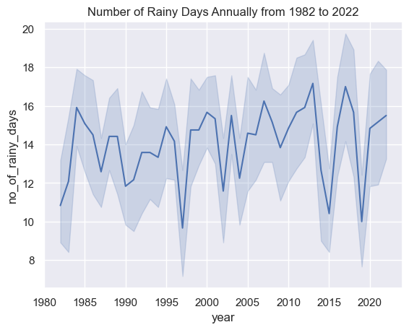
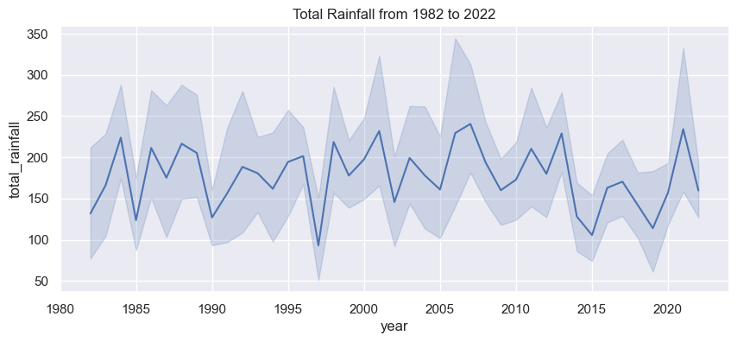
Since the 1980s annual rainfall volume has stayed constant, but the variability in the number of rainy days increased since 2010.
Q. Since the 1980s to today, has Singapore gotten warmer and rainier?
Rain
Singapore is experiencing more erratic rainfall patterns, with some years recording substantially lower rainfall and others higher.
Notes:
To answer another one of our research questions on whether Singapore has gotten rainier or warmer in the last four 4 decades, we plotted the average annual rainfall amount and number of rainy days in the last 40 years to make observations about longitudinal trends. While there weren’t major increases or decreases for rainfall amount or number of rainy days, since 2015 there does seem to be more erratic rainfall patterns – certain years see a much lower amount of rainfall while others recorded a much higher amount than the average, which might mean it will get harder to make accurate weather predictions.

Slide 18
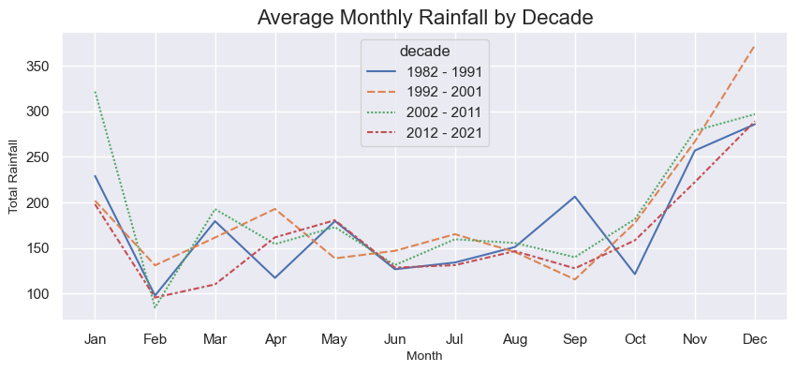
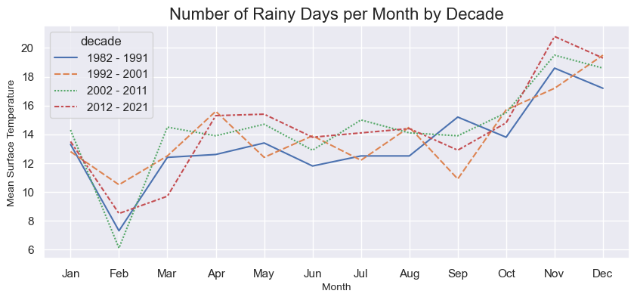
The number of rainy days from Oct-Dec has increased with each passing decade
Q. Since the 1980s to today, has Singapore gotten warmer and rainier?
Rain
A higher number of rainy days means fewer opportunities for a fun day out for tourists in the year-end months
Notes:
Are there specific months that are contributing to higher or lower rainfall? This chart shows the rainfall data by month grouped by decade. There are not much changes in terms of monthly rainfall amount, but we’re seeing a slightly higher number of rainy days during the year-end months of Oct to Dec in recent decades. This would mean lower likelihood of non-rainy days for tourists looking to spend time outdoors if they visit at the end of the year.

Slide 19
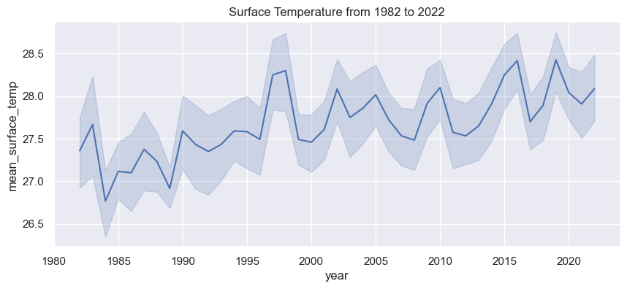
Clear upward trend in surface temperature over the last 40 years
Q. Since the 1980s to today, has Singapore gotten warmer and rainier?
Heat
Notes:
A similar line graph was done to look at surface temperatures in Singapore over the last 40 years. This time, we see a clear upward trend, indicating that Singapore has actually gotten warmer over time.

Slide 20
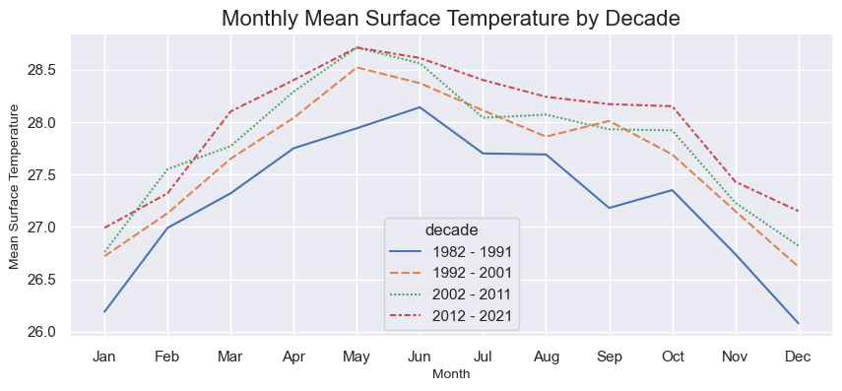
The increase in surface temperatures is consistent across all months
Q. Since the 1980s to today, has Singapore gotten warmer and rainier?
Heat
Our warmest months are getting warmer:
higher risk of heat-related stress on people spending time outdoors
Notes:
Which are the months recording higher temperatures? The increase is fairly uniform across all months, and one point of concern is that that Singapore’s hottest months of Apr-Jun are actually getting warmer, which means that the risk of heat-related health problems while spending extended time outdoors is likely to increase in the future. The higher temperatures could be due to climate change, as well as the urban heat island effect that Zhiming mentioned earlier as part our external research.

Slide 21
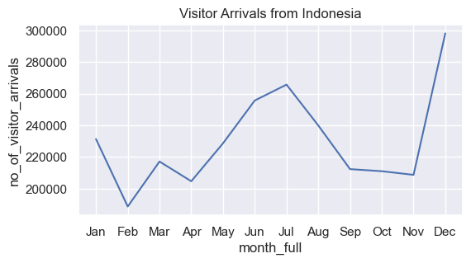
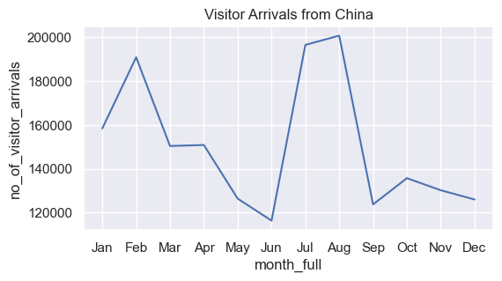
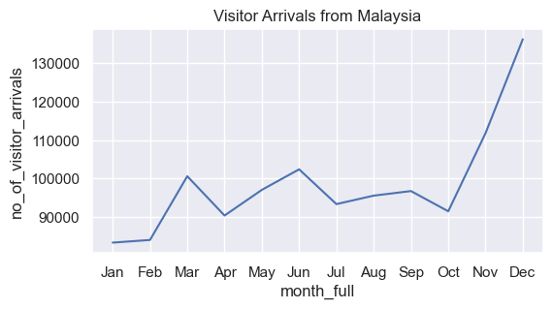
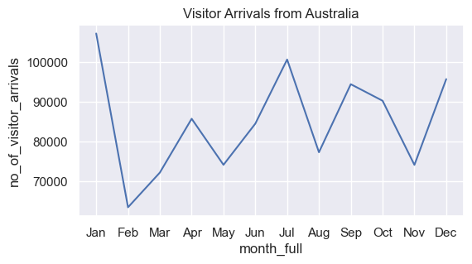
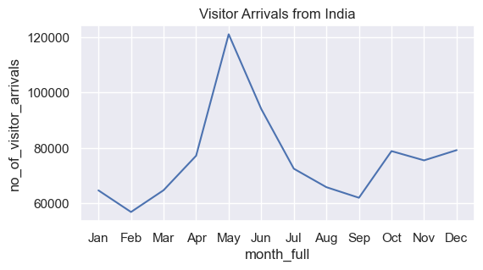
Top 5 countries of origin for tourists are Indonesia, China, Malaysia, Australia and India. Visitorship patterns vary by country.
Additional data on visitorship statistics
Tourism
Notes:
We also looked at tourism data so that we could add more value to the subsequent insights and come up with more relevant recommendations for the STB Marketing Division.
If we zoom into the top 5 countries of origin for international visitors, we note that tourists from these countries tend to visit us at different times of the year, in line with their respective country holidays and festivals.
We want to take these nuances into consideration when coming up with specific recommendations and next steps, which my teammate Sunil will elaborate on.

Slide 22
Recommendations
Notes:
Thanks Keng Hui. Hi, I’m Sunil and I’ll be running through with you our recommendations as well as some additional insights we found during our analysis process. These recommendations will be based on the three key questions mentioned earlier.

Slide 23
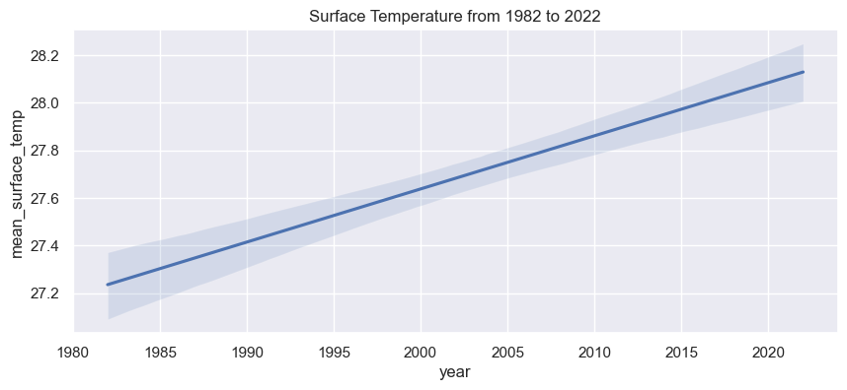

Q1. Since the 1980s to today, has Singapore gotten warmer and rainier?
Singapore has gotten warmer over the years.
Provide education about the dangers of spending too much time outdoors.
Notes:
For the first question on whether Singapore has gotten warmer over the past 40 years, the answer is yes. As Keng Hui mentioned earlier, there is a clear uptrend in temperature over the years. As the trend is likely to continue based on research, we should focus on educating tourists as well as the general public in Singapore about the dangers of spending to much time outdoors.

Slide 24
Q1. Since the 1980s to today, has Singapore gotten warmer and rainier?
Warmest Months: Apr - Jul
Coolest Months: Dec - Jan
Increase awareness for outdoor activities for Apr - Jun
Recommend Dec - Jan for coolest weather
Notes:
Emphasis can also be made on the summer months, where the temperature is highest.

Slide 25
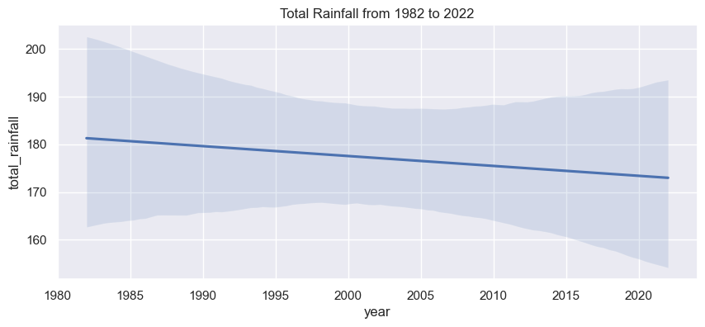
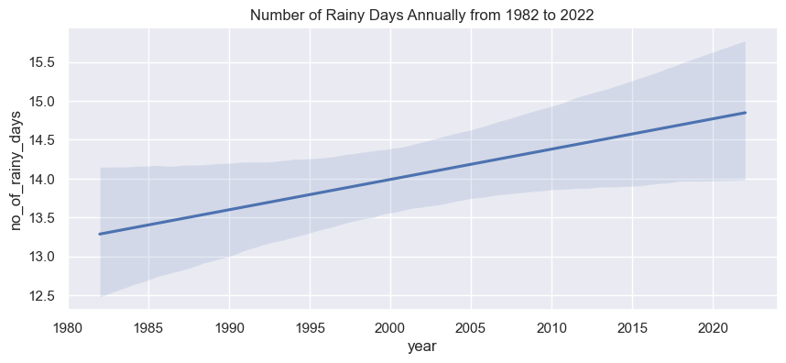
Q1. Since the 1980s to today, has Singapore gotten warmer and rainier?
Not rainier
Notes:
Now, has Singapore gotten rainier? Well, not really.

Slide 26
Q1. Since the 1980s to today, has Singapore gotten warmer and rainier?
More rain between Nov - Dec
Caution wet weather for the year end
Notes:
However, Singapore is definitely experiencing higher rainfall during November to January.

Slide 27
Q2. Which months are best for outdoor activities?
Not Very Sunny
Feb
Mar
Apr
May
Jan
Jun
Lower Wet-bulb Temperature
Dec
Jul
Not Very Rainy
Nov
Oct
Sep
Aug
Feb- Mar & Aug-Oct are best for outdoor activities
Recommend Feb - Mar & Aug-Oct for outdoors activities
Caution Nov - Jan due to rainy season
Notes:
Next, which months are best for outdoor activities? Based on our analysis, this would be Feb to Mar and Aug to Oct. Compared to the other months, these period are less likely to be very sunny or rainy and the temperature is reasonable. Basically, the weather is more predictable during these periods.
Nov-Jan are definitely not great for outdoor activities. As we all also observed ourselves, “ponding” is definitely a risk here.

Slide 28
Q3. What does this mean for tourists looking for a fun day out in Singapore?
Time trips between Feb - Mar or Aug - Oct for ideal outdoors weather
Due to humidity, wear light and breathable cloths
Bring a hat and use sunblock
Hot weather between Apr - Jul: Hydrate frequently, avoid long strenuous outdoor activities, take regular breaks
Wet weather between Nov - Jan: Pack umbrellas, ponchos, indoor activities
Notes:
Lastly, what do our findings mean for tourists looking for a fun day out? Well, they should try to plan their trips in Feb-March or Aug-Oct. Light airy cloths, hats and sunscreen are also recommended. If they are visiting during Apr-Jul, they should take caution of the higher heat, hydrate frequently and find some shade. And if they’re travelling between Nov-Jan, then best be prepared for wet weather and plan for more indoor activities.

Slide 29
Additional Insights & Future Considerations
Notes:
Now this concludes the presentation for the initial problem statement. However, we would like to take some time to run through with you some additional insights and points for future consideration that we found.

Slide 30
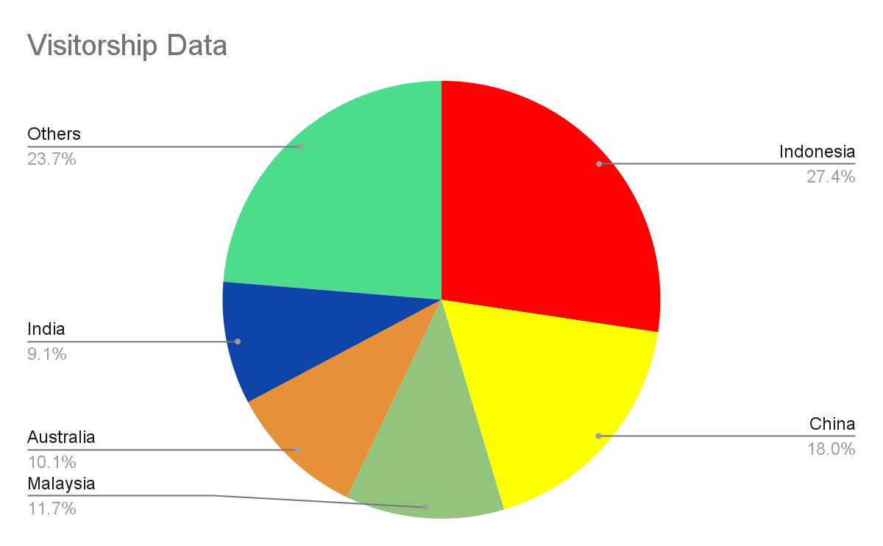
Visitorship Data
75% of visitors come from 5 countries
Have a dedicated webpage with information specific to these countries
Tailored recommendations for what to pack, activities, attractions
Send customized email plans before peak visitorship
Notes:
During our analysis, we also looked at visitorship data and identified the top five countries of origin. It might make sense for the team to have a dedicated webpage for visitors from these countries with tailored information for them. For example, we could suggest what to pack, activities to do, attractions to see and also perform targeted marketing.

Slide 31

For Future Consideration
Analyze motivation for specific country peak period
Recommend specific activities based on tourist motivations
Resource planning for activities to cater tourist profile
Notes:
If the marketing team feels that the visitorship data would be useful, in a future engagement with our team, we could perform a further analysis. Here we have a brief example. We could look into the motivations for specific country peak periods, which would allow us to recommend more specific activities and ensure enough resources are available.
By looking at the tourists' motivations, more specific activities could be recommended (e.g. tourists escaping winter could be looking for more outdoor/sunny activities)

Slide 32
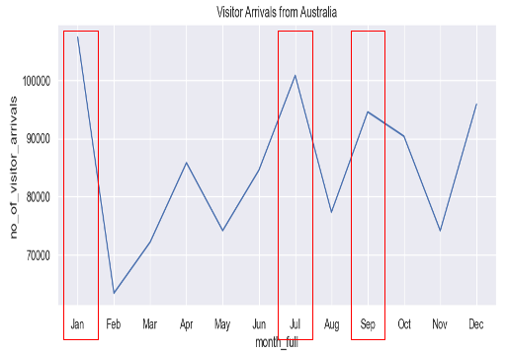
Australia Example
Jan (Summer school holidays): Cater child/family friendly activities + Christmas shopping
July ( Winter & school holidays): Cater child/family friendly activities and outdoor activities
Sep: No obvious insight. Requires further analysis
Notes:
If we look at Australia, peak visitor periods are in Jan, Jul and Sep. Jul is winter and the school holidays, so outdoor/sunny and family and child-friendly activities could be recommended. Jan is the summer school holiday, so outdoor activities might not be the main motivation here. More family and child-friendly activities would be good. Christmas shopping might also be on the agenda as the peak period actually begins in mid-Dec.

Slide 33
Questions?
Notes:
Well, that’s it for our presentation. We could take questions if you have any. Thank you.

